Slide 1


INTEGRATED PROJECT – SUMMER 2024
Introductory Session
Team Arocha
Actuarial Science Program
May 23, 2024

Slide 2
AGENDA
01 | Introduction
02 | Logistics
03 | Business Context
04 | Problem Definition
05 | Loss distributions

Slide 3
Introduction
Course objectives
Increased technical skills and consulting-related soft skills
Enhanced opportunity to be successful in the marketplace
Students
Produce a statement of work, including timeline
Act as consultants
Provide status update report
Send agenda for approval, prior to each session
Upload approved agenda and meeting minutes to Canvas after each session with mentor
Provide project deliverables
Act with professionalism
Mentor
Sets up a project for the course
Acts as the client, but also as a mentor (i.e., provides guidance on both technical and soft skills, and industry knowledge)

Slide 4
Introductions
Ruizhe Qiu

Slide 5
Introductions
Tianxiang Zheng

Slide 6
Introductions
Luyang Feng

Slide 7
Introductions
Orange Ao

Slide 8
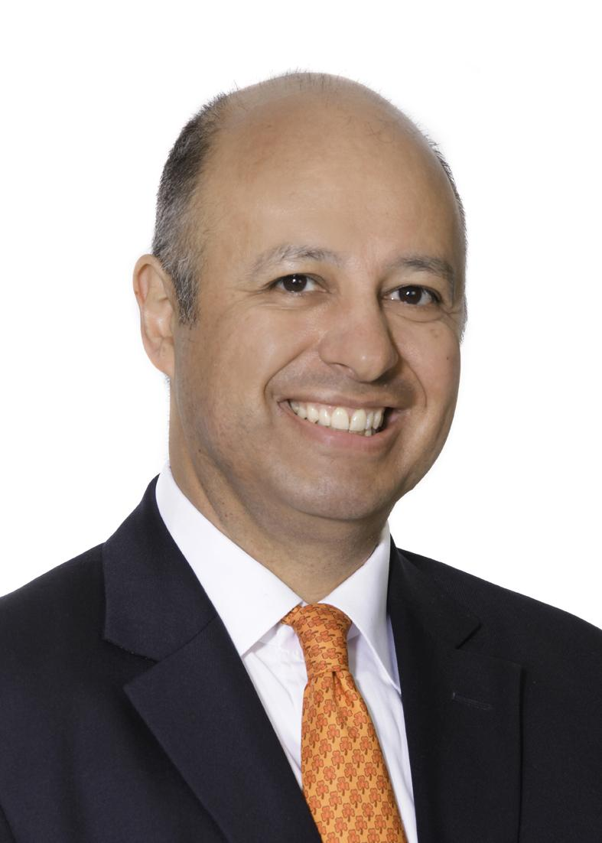
Introductions
Carlos Arocha
Managing Partner at Arocha & Associates, in Zurich
30+ years of global expertise in life and P&C re/insurance: quantitative risk modeling, IFRS 17, risk-based capital, Solvency II, Swiss Solvency Test, P&C reserve audits, ALM, and Enterprise Risk Management
Lecturer, Master in Actuarial Science Program, Columbia University
Lecturer, exams P/FM, Anahuac University
Fellow of the Society of Actuaries and Member of the Swiss Association of Actuaries

Slide 9
Deliverables
Statement of work
Midterm presentation
Final presentation
Final report

Slide 10
Logistics
Meetings with mentor
Biweekly on weeks 1—3, then weekly
Mandatory attendance
Agenda should be set up by students and sent to mentor for approval within 24 hrs. prior to meetings (then upload to Canvas)
Meeting minutes should be sent to mentor for approval within 24 hrs. after meetings (then uploaded in Canvas)
Team collaboration tool
Trello
Record activities, status, owners, etc.

Slide 11
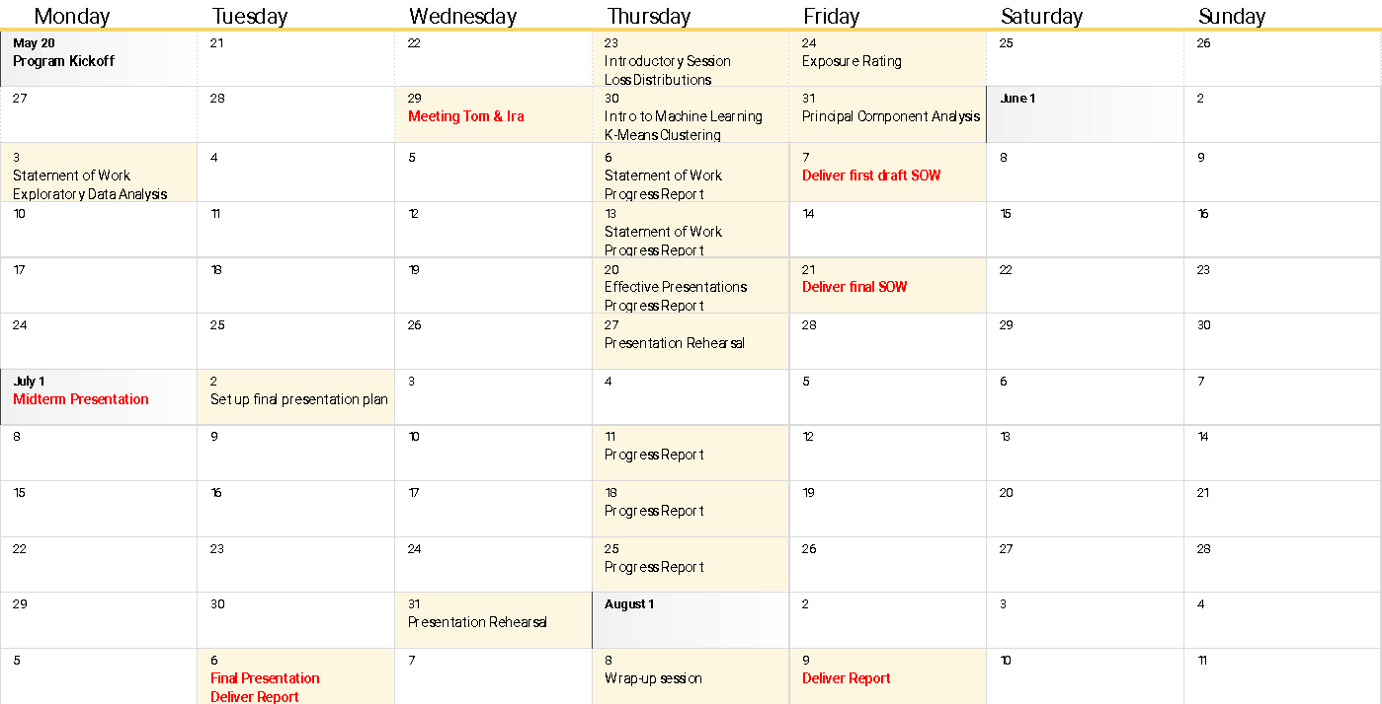

Slide 12
Business Context
Columbia Insurance Company (CIC) writes property insurance for individuals and companies
Property insurance indemnifies the insured for the loss or damage to the insured’s property, such as one’s house or one’s car
Property policies are characterized by short-tail claims and a relatively low frequency of significant claims
The severity of the claims is usually capped by the maximum value of the property, but most losses will be smaller than the maximum probable loss (MPL)
The accurate pricing of property often requires the use of catastrophe models and market severity curves (also known as exposure curves)

Slide 13
Problem Definition
Over the past few years, CIC has experienced significant growth.
Initially focused solely on homeowners’ insurance, CIC has now diversified its product palette to include commercial and industrial property, auto, marine cargo, aviation hull, and other lines. To improve its pricing strategy, CIC aims to redefine its risk classes and charge premiums commensurate with the risk.
However, due to a lack of actuarial resources, CIC is seeking external consultants to propose new pricing protocols.
Following initial meetings with your Managing Director, it has been agreed that a potential solution may be the use of exposure rating techniques. However, before this, unsupervised machine learning will be used to extract information from claims data.

Slide 14
Loss Elimination Ratio
Ratio of the decrease in the expected payment with a deductible to the expected payment without the deductible

